Slide 1
Bank Marketing Campaign Subscribtion
Using Machine Learning Models

Slide 2
Overview :-
The dataset contains information on marketing campaigns conducted by a banking institution via phone calls to clients.
The goal of these campaigns is to encourage clients to subscribe to a specific financial product (term deposit).
Each call outcome is recorded as either successful (client subscribed) or unsuccessful (client did not subscribe).
The dataset consists of 41,188 rows (instances of calls) and 21 columns (variables) describing various aspects of the calls.
Some clients were contacted multiple times, but each call is treated independently for analysis purposes.
The analysis will focus on understanding factors influencing campaign success and predicting client subscription to the product.

Slide 3
Topics :-
Importing Libraries
Data Preprocessing
Model Evaluation Metrics
Apply Classification Models
Approach to XGboost
Apply PCA
Conclusion

Slide 4
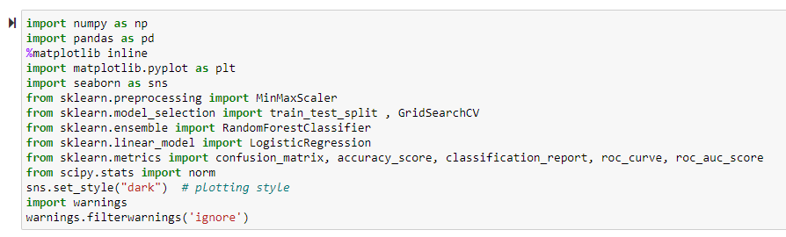
Importing Libraries :-

Slide 5
Importing Libraries :-
libraries commonly used for data analysis, visualization, preprocessing, and modeling.
Pandas:- Used for Data Manipulation and analysis . It provides data structures like DataFrame for handling tabular data.
Numpy :- Provides support for numerical operations and computations. It's often used for handling numerical data efficiently.
Matplotlib :- A plotting library used for creating static, interactive, and animated visualizations in Python.
SeaBorn :-Built on top of matplotlib, seaborn provides a high-level interface for drawing attractive and informative statistical graphics.
Sklearn (scikit-learn ):-A machine learning library that provides simple and efficient tools for data analysis and modeling. It includes various algorithms for classification, regression, clustering, etc.

Slide 6
Importing Libraries :-
Train – Test –Split :- A function from sklearn used to split the dataset into training and testing sets for model evaluation.
StandardScaler :-Used for standardizing numerical features by removing the mean and scaling to unit variance.
Decision Tree classifier , Random Forest Classifier :- Algorithms for building decision tree and random forest models, respectively.
accuracy_score. confusion_matrix, classification_report :- Functions for evaluating the performance of classification models by calculating accuracy, confusion matrix, and classification report metrics.

Slide 7
Data Preprocessing :-
Data preprocessing is a crucial step in the data analysis pipeline that involves transforming raw data into a format that is suitable for analysis and modeling. –
common techniques used in data preprocessing:
Handling Missing Values:-
Data Cleaning:-
Data Transformation :- Encoding categorical variables
Scaling numerical features
Handling outliers
Feature engineering

Slide 8
Data Preprocessing :-
Feature Selection :-
Select relevant features that are most useful for predicting the target variable. This can help reduce dimensionality and improve model interpretability and performance.
Splitting Data:-
Split the dataset into training, validation, and testing sets to evaluate and validate the performance of machine learning models. The training set is used to train the model, the validation set is used to tune hyperparameters, and the test set is used to evaluate the final model performance.

Slide 9
Model Evolution Metrics :-
Model evaluation metrics are used to assess the performance of machine learning models.
Classification Metrics:
Accuracy: The ratio of correctly predicted observations to the total observations. It's suitable when the classes in the dataset are balanced.
Precision: The ratio of correctly predicted positive observations to the total predicted positive observations. It measures the model's ability to avoid false positives.
Recall (Sensitivity): The ratio of correctly predicted positive observations to the total actual positive observations. It measures the model's ability to identify all relevant cases.
F1 Score: The harmonic mean of precision and recall. It balances precision and recall, providing a single metric that combines both.
ROC AUC Score: The Area Under the Receiver Operating Characteristic curve. It measures the model's ability to distinguish between classes, irrespective of the threshold.
Confusion Matrix: A table showing the number of true positives, false positives, true negatives, and false negatives.

Slide 10
Model Evolution Metrics :-
Regression Metrics:
Mean Absolute Error (MAE): The average of the absolute differences between predictions and actual values. It provides a robust measure of the average prediction error.
Mean Squared Error (MSE): The average of the squared differences between predictions and actual values. It penalizes large errors more than MAE.
Root Mean Squared Error (RMSE): The square root of MSE. It's in the same unit as the target variable, making it more interpretable.
R-squared (R2): The proportion of the variance in the dependent variable that is predictable from the independent variables. It ranges from 0 to 1, with higher values indicating better fit.

Slide 11
Apply Classification Model :-
I've chosen the Random Forest classification model to predict subscriptions based on marketing campaign data.
Random Forest Classifier is a versatile machine learning algorithm , Here's a summary of its key characteristics and features:
Ensemble Learning:
Random Feature Selection
Bootstrap Aggregation (Bagging):
Decision Tree Parameters
Feature Importance:
Robustness to Overfitting
Parallelization:

Slide 12
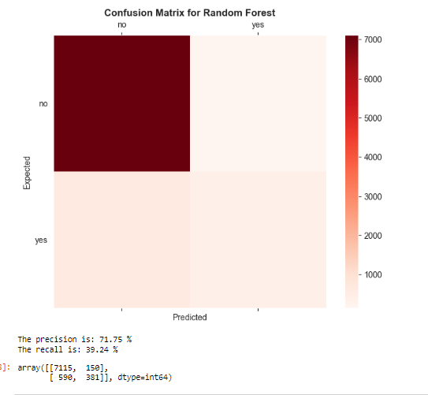
Confusion Matrix After RFC :-

Slide 13
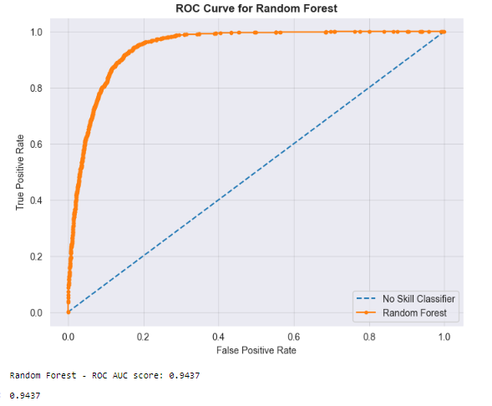
ROC Curve After RFC :-

Slide 14

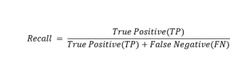
the model shows very good at predicting clients who are not going to subscribe (negative class) ,
But did not perform very well in the case of the positive class, as it classified correctly approximately 39% of the total clients who end up subscribing for the product.
here i will try apply xgboost classifire ,
Let see whether my model can perform better in the case of the positive class or not??

Slide 15
XGBoost (eXtreme Gradient Boosting) Boosting Technique
XGBoost stands for eXtreme Gradient Boosting.
It is a powerful and efficient implementation of the gradient boosting framework, which is a machine learning technique for regression and classification problems.
some key features and concepts related to XGBoost:-
Gradient Boosting
Decision Trees
Regularization
Gradient Optimization
Cross-Validation
XGBoost is known for its accuracy, speed, and scalability, making it a popular choice for various machine learning tasks,

Slide 16
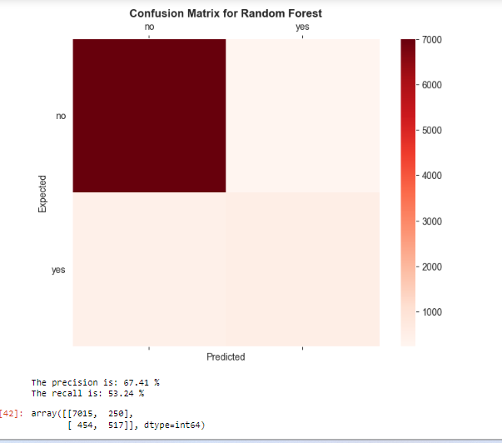
Confusion Matrix After XGBoost Technique:-

Slide 17
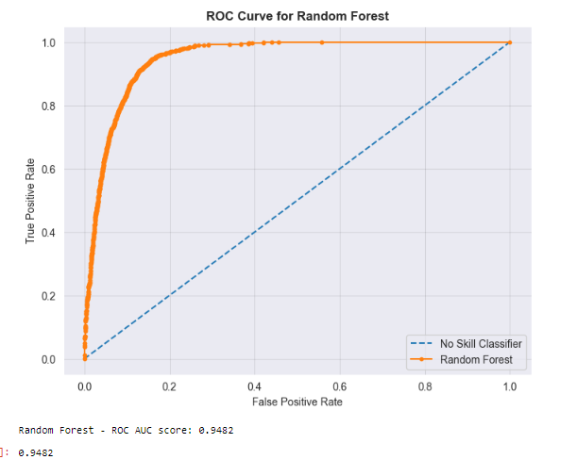
ROC Curve After XGBoost Technique:-

Slide 18
Previous model [Random Forest Classifire] = subscription(yes)- 39%
Proposed model [XGboost Classifire] = subscription(yes)- 53%
reduction of noise in the data, feature selection (to a certain extent), and the ability to produce independent, uncorrelated features of the data
Applying PCA (Principle Component Analysis )

Slide 19
Applying PCA (Principle Component Analysis )
Principal Component Analysis (PCA) is a dimensionality reduction technique used in data analysis and machine learning. It aims to reduce the number of features in a dataset while preserving most of the information present in the original data. PCA achieves this by transforming the original features into a new set of orthogonal features called principal components.

Slide 20
Applying PCA (Principle Component Analysis )
Principal Component Analysis (PCA) is a dimensionality reduction technique used in data analysis and machine learning. It aims to reduce the number of features in a dataset while preserving most of the information present in the original data. PCA achieves this by transforming the original features into a new set of orthogonal features called principal components.

Slide 21
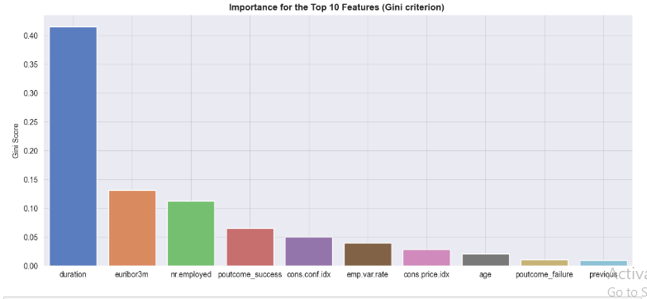
Top 10 Features Based on their Gini Score:-

Slide 22
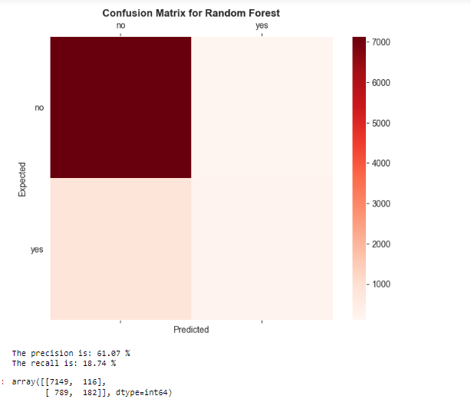
After applying Principal Component Analysis (PCA) to reduce the dimensionality of the dataset, we reapply the XGBoost technique to train a new model. The model's performance is evaluated to assess its effectiveness in predicting the target variable, providing insights into the impact of dimensionality reduction on the model's predictive capabilities

Slide 23
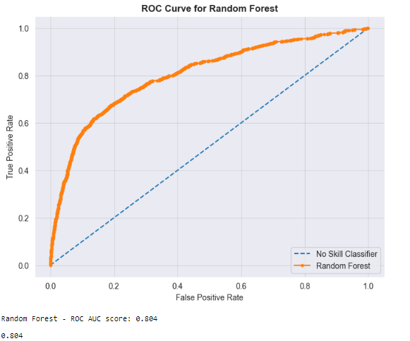

Slide 24
Conclusion :-
Though the precision and recall score is pretty low but the ROC AUC score is not that bad!!
I have compare my new model (Xgboost) with the existing model (RF) in terms of classified correctly the total clients who end up subscribing for the product.

Slide 25
Thank You !!!!

